Slide 1
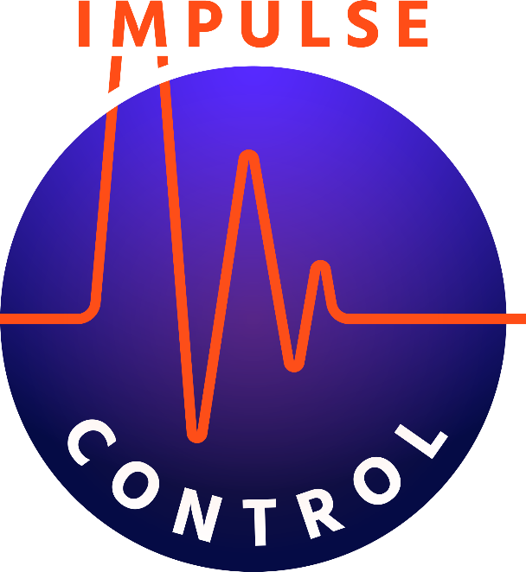
VR Conversion Revit to Unity
E-mail: admin@impulsectrl.com
Website: www.impulsectrl.com/play
Twitter: @ctrl_impulse

Slide 2
Purpose/Potential Uses
Introduce methods used to create Virtual Reality (VR) buildings
Describe steps for converting Revit models to VR
Review the potential costs for hardware and software

Slide 3
What is presence?
Gives users a sense of scale, depth and spatial awareness that simply cannot be matched by a rendering, walkthrough or physical scale model.
Users have the freedom to explore a building at their own pace, to understand how it will feel and function. Walking across rooms, teleporting through doors, peering around corners.
“Impulse Control” has used the following workflow to create presence on 3 different building projects.

Slide 4
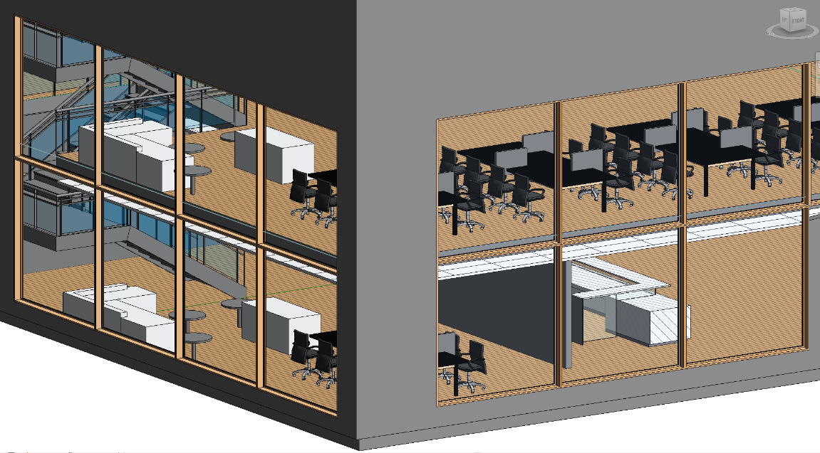
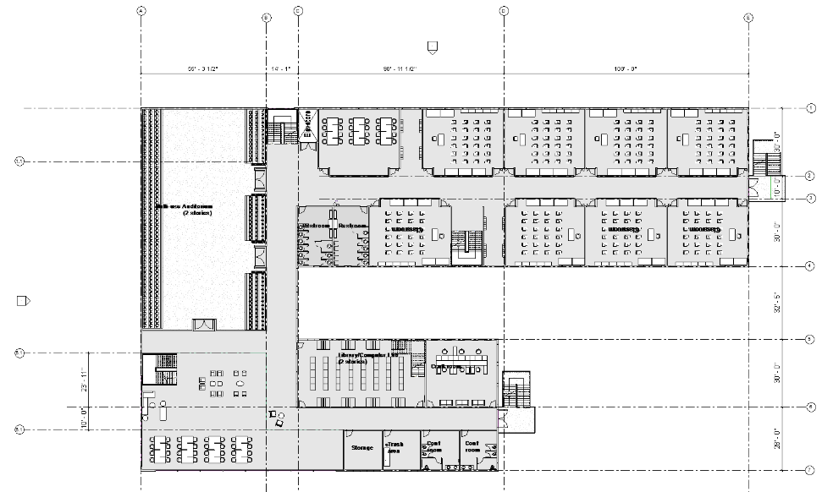
Autodesk Revit
Autodesk Revit is Building Information Modeling (BIM) software for Microsoft Windows, which allows the user to design with parametric modeling and drafting elements. It is used by Architectural and Structural teams to produce design and construction documentation for building structures.

Slide 5
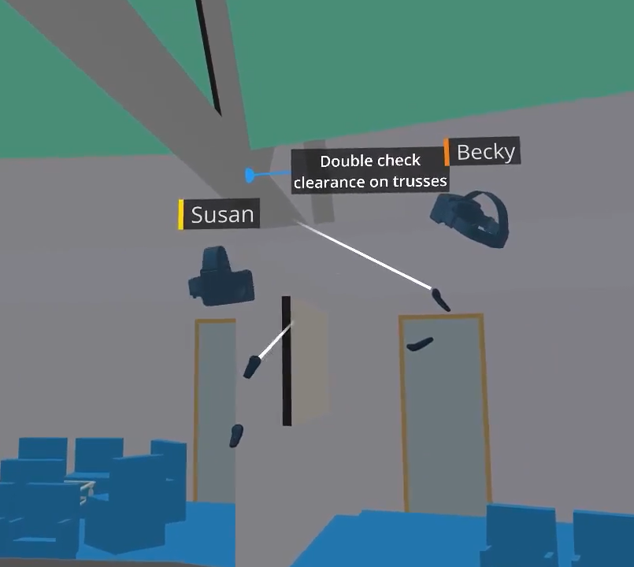
Market Research: InsiteVR
Pros
Fast immersion into virtual environment
Doesn’t require a powerful PC (wireless headset)
Built-in team meeting capability (collaboration)
Useful in the field for contractors
Cons
Modifications made in native software (Revit)
Limited interactivity with equipment

Slide 6
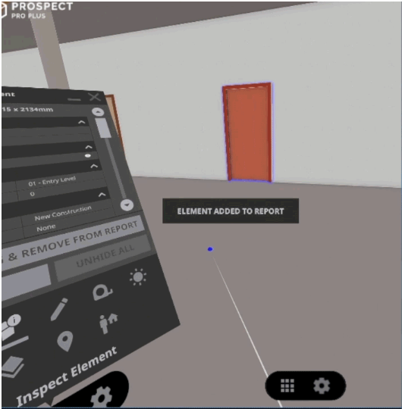
Market Research: Prospect
Pros
30 seconds or less conversion to VR
Collaborative design review feature
Cons
Requires a powerful computer
Does not allow for object interaction

Slide 7
Unity Virtual Reality
Unity is a cross-platform game engine that can be used to create 3D, 2D, VR/AR games and simulations
PiXYZ adds a menu option in the Unity editor that allows you to directly import CAD models into a project

Slide 8
Pros/Cons PiXYZ and Unity Reflect (Unity plugins)
Pros
Interactive modeling and flexible programming capabilities
High quality graphics
Cons
Requires a powerful computer
Limited measurement/markup capabilities at this time
Limited collaboration features

Slide 9
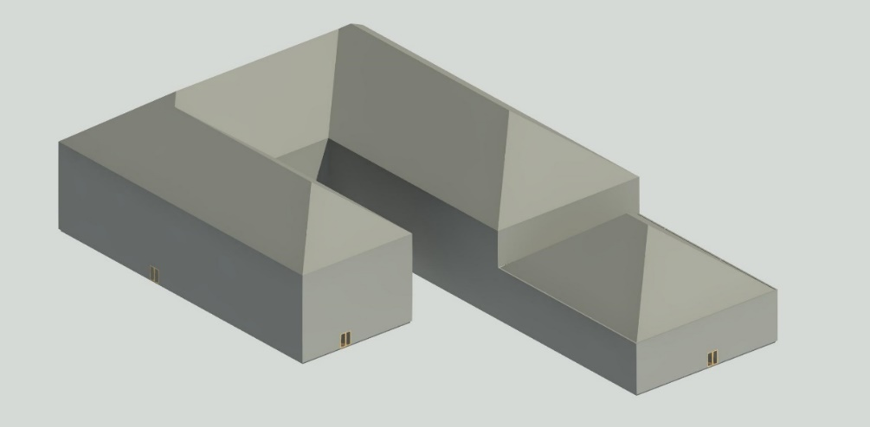
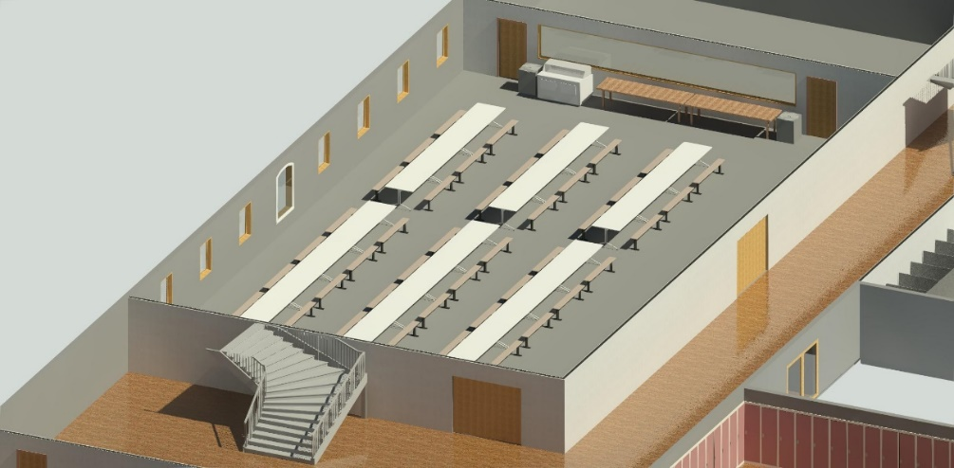
Revit Renders

Slide 10
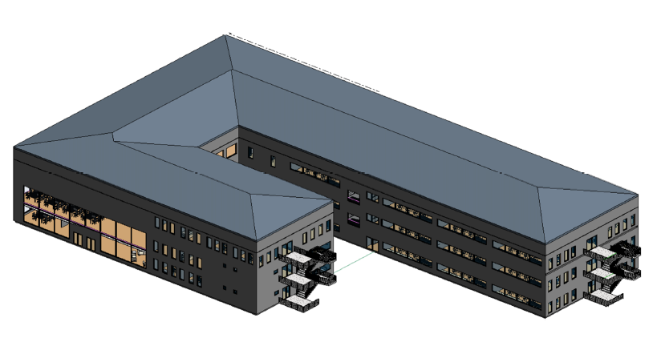
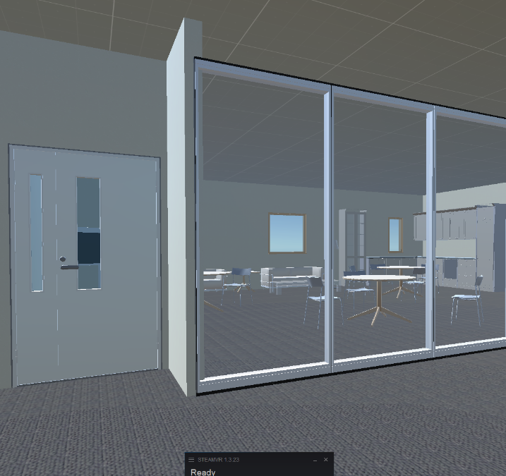
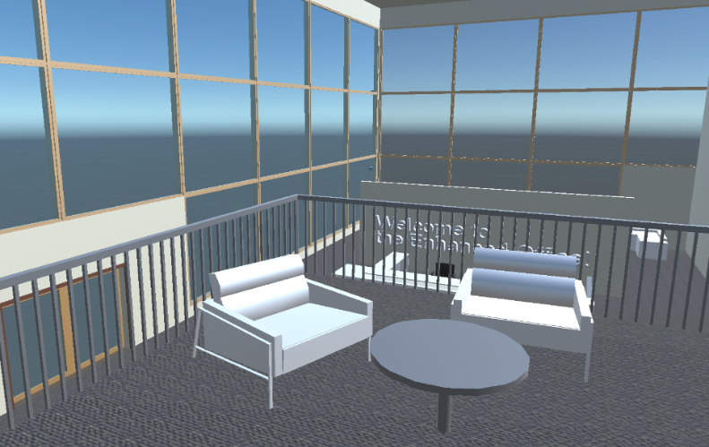
Unity Renders

Slide 11
Expenses and income
Expenses (software)
Unity Reflect
Unity Pro $125/mo.
and Reflect Revit Plug-in $670/yr.
and/or PiXYZ $1140/yr.
Expenses (hardware)
Dell G5 desktop $1,765
HTC Vive headset $600
Income
Preparation of one model, with Revit file provided, could take 40 hours
At a rate of only $40/hr, initial costs will be recouped after 2 projects.
By comparison, an InsiteVR license is $1,200/yr for one project with support
VDC firms (Virtual Design and Construction) have large overhead and billable rates over $100/hr

Slide 12
Business Proposition
As the AEC (Architecture, Engineering and Construction) industries embrace modeling technology, building and equipment information is readily available which will narrow the gap between the Owner and the design team.
The early adopters of VR have made investments to tackle challenging clash detection and constructability issues, which also keeps out competition. Design teams are focused on details and VR is an unnecessary distraction for experienced designers.
The building owner is entitled to information contained in their building model. Both the design team and the owner will benefit from an immersive walkthrough, without interrupting their internal processes.
Governed by the boundaries of experience and capability, low cost is our main selling point. The process is streamlined over time to increase offerings to the client.

Slide 13
Thank you
What is this project?
The Revit file for the University building was originally created by my classmates and me in a team project in 2015. I received a VR headset courtesy of Microsoft at the Unity event in DTLA last year. The Revit to PiXYZ workflow was also used to create a VR walkthrough for a Research project and work assignment. The technology is used by Architects and Engineers in construction.
What’s with the name?
The purpose of Impulse Control is to develop a realistic structural response model for video games. The Impulse represents a seismic wave, and Control is the desired behavior of the structure, like in a base-isolated building for example. In the 2D game, I am striving to help younger people identify with a personality type. If you are working on a game or other project that needs a building model, I can help! If you or someone you know creates buildings in video games, I’d like to hear how it’s done!
Twitter: @_ImpulseCtrl
E-mail: admin@impulsectrl.com
Website: www.impulsectrl.com/play

